Slide 1












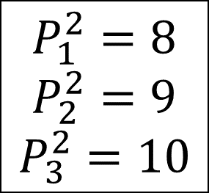




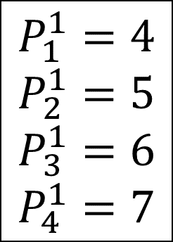
Free vehicles
$$Q_{1}$$
$$Q_{12}$$
$$𝒬_{12}=\left\{1,2,3,…,11\right\}$$
$$Q_{2}$$
$$Q_{3}$$
$$𝒬_{3}=\left\{1,2,4,5,…,12\right\}$$
$$Q_{11}$$
$$𝒬_{5}=\left\{4,6\right\}$$
$$P_{1}^{1}=4$$
$$P_{2}^{1}=5$$
$$P_{3}^{1}=6$$
$$P_{4}^{1}=7$$
Platoon 1
$$Q_{7}$$
$$Q_{6}$$
$$Q_{5}$$
$$Q_{4}$$
$$P_{1}^{2}=8$$
$$P_{2}^{2}=9$$
$$P_{3}^{2}=10$$
Platoon 2
Leader vehicles
$$Q_{10}$$
$$Q_{9}$$
$$Q_{8}$$
$$𝒬_{8}=\left\{9\right\}$$
Follower vehicles

